Slide 1
Auto Lease Pricing Under Economic Uncertainty
Michael Vogan, Asst. Director
Sept. 2018

Slide 2
Presenters
Michael Vogan is an Assistant Director, Lead Auto Economist. He analyzes the impact of the economy on the auto industry and credit markets and manages the Moody’s Analytics residual vehicle value forecast models.
Alex Lowy is a Regional Account Associate with Moody’s Analytics, focusing on the firm’s auto loss-forecasting solutions. Alex supports clients using Moody’s Analytics residual value forecasting and credit loss models as well as scenario forecasting tools.

Slide 3
Questions to Consider
What has been driving increased residual value losses?
How should residual value risk be measured?
How much value can be assigned to the end-of-term option to buy?
Are certain vehicles riskier than others?
What is the optimal residual value given possible future economies?
How is the market positioned in terms of expected and unexpected losses?

Slide 4
Residual Values – Anything Can Happen
MA Retention Value Index, Jan. 2010 = 100, by econ. scenario
Forecast
Sources: NADA, Moody’s Analytics

Slide 5
Auto Lease Residuals Were Inflated…
Avg. inflation of contract over base RV, %, by orig. date
Sources: Edgar Online, Moody’s Analytics

Slide 6
… Creating Residual Value Losses
Est. RV losses on returned vehicles in 2017 by RV source
Sources: NADA, Edgar Online, Moody’s Analytics

Slide 7
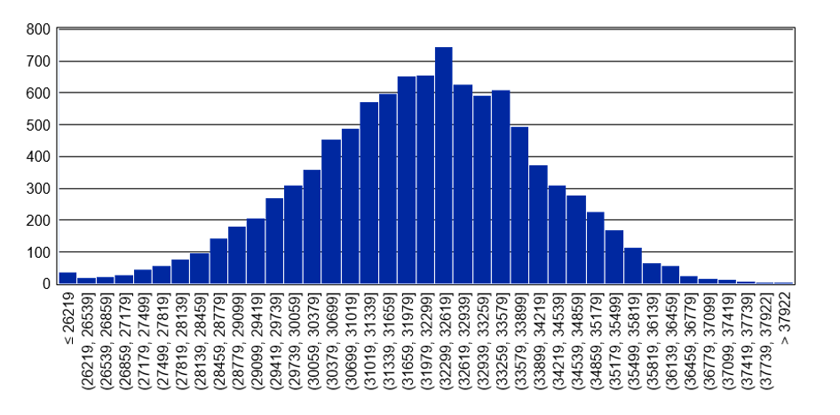
Economic Simulation Quantifies Risk
39 month residual value forecast, 10K econ sims
Unexpected RV loss
In-the-money option
Expected 2017 F150 Residual Value
Sources: NADA, Moody’s Analytics Auto Portfolio Analyzer

Slide 8
Purchase Option Value
Lessee option to purchase vehicle at end of term can be priced using the Black-Scholes model
Five factors influence lease purchase option price:
Present value of expected residual value
Contract residual value
Residual value volatility
Term
Risk-free interest rate

Slide 9
Option Value Varies by Vehicle Type
36 month new vehicle leases, 10K econ sims
Model (2018 MY) | Lease Price ($) | Contract Residual ($) | RV Volatility (Ann. % chg.) | Option Value ($)
Camry | 29,000 | 14,762 | 1.37 | 131.60
RAV4 | 29,024 | 16,921 | 3.81 | 419.46
Prius | 23,414 | 10,622 | 7.69 | 531.16
Tundra | 44,628 | 27,162 | 8.86 | 1,564.52
Note: Option value derived using Black-Scholes option pricing model.
Sources: Moody’s Analytics Auto Portfolio Analyzer

Slide 10
Residual Subvention Lowers Option Value
Option value, $, by contract RV in thousands, 10K econ sims
Expected 2017 F150 Residual Value
Sources: Moody’s Analytics Auto Portfolio Analyzer

Slide 11
Auto Lease Call Options Are Incomplete
2017 ABS return rates, by residual value loss, % of contract RV
Sources: NADA, Edgar Online, Moody’s Analytics

Slide 12
Optimal Residual Value Definition
Let there be N possible macroeconomic paths for a lease of term T months. Assume 0 default or prepayment risk. Then the expected profit in economy n is defined as:
$${Interest}_{t}=\frac{\left(leasePrice+contractRV\right)∗APR}{2400}$$
${Eπ}_{n}= \sum_{T}{{interest}_{t}{− PR}_{n,T}∗(contractRV−{marketRV}_{n,T})}$
And the optimal contractual residual value is:
$${\text{c}\text{ontractRV}\text{∗ =}Max}_{contractRV} \sum_{N}{P_{n} ∗ {Eπ}_{n} }$$
Where:
${interest}_{n,t}$ = Interest payment in economy n at time t
${PR}_{n,T}$ = Probability of return in economy n at lease end
${marketRV}_{n,T}$ = Expected sale price of vehicle in economy n at lease end
$P_{n}$ = Probability of economy n

Slide 13
Return Behavior Impacts Optimal Price
Expected profit and return rate by contract RV, 10K econ sims
Expected 2017 F150 Residual Value
Sources: Moody’s Analytics Auto Portfolio Analyzer

Slide 14
Expected Profits Carry Unexpected Risk
Expected and unexpected profit by contract RV, 10K econ sims
Expected 2017 F150 Residual Value
Sources: Moody’s Analytics Auto Portfolio Analyzer

Slide 15
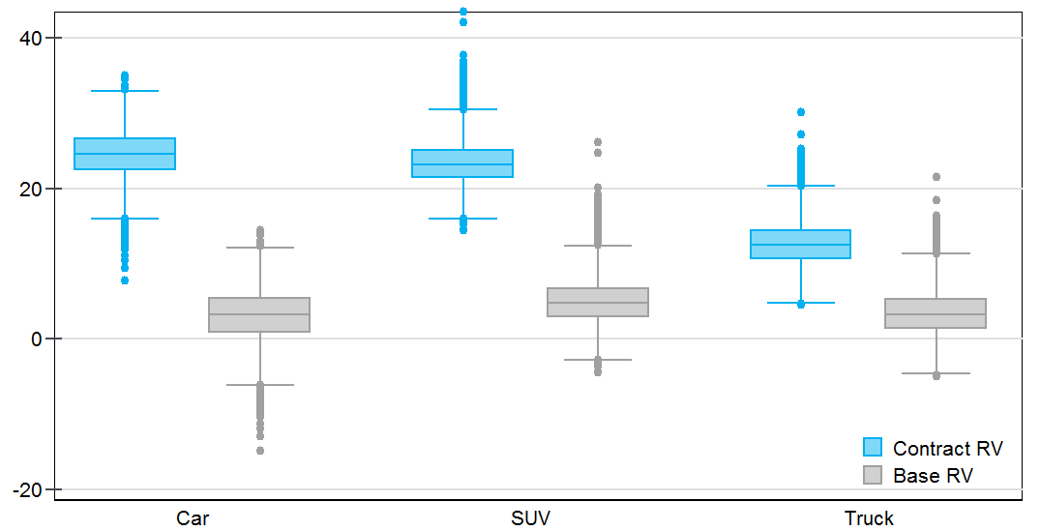
Very Little Option Value In Leasing Market
RV loss distributions for outstanding ABS leases Jan. 2018, %
Sources: Edgar Online, Moody’s Analytics Auto Portfolio Analyzer

Slide 16
Conclusion
Simulated residual value distributions quantify unexpected losses and option value
This information can be used to better understand risks and rewards when setting residual values, leading to more efficient pricing strategies
Unexpected losses and option values vary by macroeconomic sensitivity across vehicle types
The end-of-term return rate is a predictable and influential factor in managing residual value risk
Residual value subvention, even if subsidized by the manufacturer, increases residual value risk by lowering option value
A competitive leasing market has driven residual values too high, creating a high exposure to downside economic shocks

Slide 17
Q&A
Additional questions?
Send an email to help@economy.com or contact:
Alex Lowy
alexander.lowy@moodys.com
610-235-5206
Follow us: www.moodysanalytics.com/auto

Slide 18
United States
121 North Walnut Street
Suite 500
West Chester PA 19380
+1.610.235.5299
United Kingdom One Canada Square Canary Wharf London E14 5FA +44.20.7772.5454
Australia Level 10 1 O'Connell Street Sydney, NSW, 2000 Australia +61.2.9270.8111
Singapore 6 Shenton Way
#14-08 OUE Downtown 2
Singapore 068809 +65.6511.4400
Czech Republic Washingtonova 17 110 00 Prague 1 Czech Republic +420.22.422.2929
moodysanalytics.com

Slide 19
© 2018 Moody’s Corporation, Moody’s Investors Service, Inc., Moody’s Analytics, Inc. and/or their licensors and affiliates (collectively, “MOODY’S”). All rights reserved.
CREDIT RATINGS ISSUED BY MOODY'S INVESTORS SERVICE, INC. AND ITS RATINGS AFFILIATES (“MIS”) ARE MOODY’S CURRENT OPINIONS OF THE RELATIVE FUTURE CREDIT RISK OF ENTITIES, CREDIT COMMITMENTS, OR DEBT OR DEBT-LIKE SECURITIES, AND MOODY’S PUBLICATIONS MAY INCLUDE MOODY’S CURRENT OPINIONS OF THE RELATIVE FUTURE CREDIT RISK OF ENTITIES, CREDIT COMMITMENTS, OR DEBT OR DEBT-LIKE SECURITIES. MOODY’S DEFINES CREDIT RISK AS THE RISK THAT AN ENTITY MAY NOT MEET ITS CONTRACTUAL, FINANCIAL OBLIGATIONS AS THEY COME DUE AND ANY ESTIMATED FINANCIAL LOSS IN THE EVENT OF DEFAULT. CREDIT RATINGS DO NOT ADDRESS ANY OTHER RISK, INCLUDING BUT NOT LIMITED TO: LIQUIDITY RISK, MARKET VALUE RISK, OR PRICE VOLATILITY. CREDIT RATINGS AND MOODY’S OPINIONS INCLUDED IN MOODY’S PUBLICATIONS ARE NOT STATEMENTS OF CURRENT OR HISTORICAL FACT. MOODY’S PUBLICATIONS MAY ALSO INCLUDE QUANTITATIVE MODEL-BASED ESTIMATES OF CREDIT RISK AND RELATED OPINIONS OR COMMENTARY PUBLISHED BY MOODY’S ANALYTICS, INC. CREDIT RATINGS AND MOODY’S PUBLICATIONS DO NOT CONSTITUTE OR PROVIDE INVESTMENT OR FINANCIAL ADVICE, AND CREDIT RATINGS AND MOODY’S PUBLICATIONS ARE NOT AND DO NOT PROVIDE RECOMMENDATIONS TO PURCHASE, SELL, OR HOLD PARTICULAR SECURITIES. NEITHER CREDIT RATINGS NOR MOODY’S PUBLICATIONS COMMENT ON THE SUITABILITY OF AN INVESTMENT FOR ANY PARTICULAR INVESTOR. MOODY’S ISSUES ITS CREDIT RATINGS AND PUBLISHES MOODY’S PUBLICATIONS WITH THE EXPECTATION AND UNDERSTANDING THAT EACH INVESTOR WILL, WITH DUE CARE, MAKE ITS OWN STUDY AND EVALUATION OF EACH SECURITY THAT IS UNDER CONSIDERATION FOR PURCHASE, HOLDING, OR SALE.
MOODY’S CREDIT RATINGS AND MOODY’S PUBLICATIONS ARE NOT INTENDED FOR USE BY RETAIL INVESTORS AND IT WOULD BE RECKLESS AND INAPPROPRIATE FOR RETAIL INVESTORS TO USE MOODY’S CREDIT RATINGS OR MOODY’S PUBLICATIONS WHEN MAKING AN INVESTMENT DECISION. IF IN DOUBT YOU SHOULD CONTACT YOUR FINANCIAL OR OTHER PROFESSIONAL ADVISER.
ALL INFORMATION CONTAINED HEREIN IS PROTECTED BY LAW, INCLUDING BUT NOT LIMITED TO, COPYRIGHT LAW, AND NONE OF SUCH INFORMATION MAY BE COPIED OR OTHERWISE REPRODUCED, REPACKAGED, FURTHER TRANSMITTED, TRANSFERRED, DISSEMINATED, REDISTRIBUTED OR RESOLD, OR STORED FOR SUBSEQUENT USE FOR ANY SUCH PURPOSE, IN WHOLE OR IN PART, IN ANY FORM OR MANNER OR BY ANY MEANS WHATSOEVER, BY ANY PERSON WITHOUT MOODY’S PRIOR WRITTEN CONSENT.
All information contained herein is obtained by MOODY’S from sources believed by it to be accurate and reliable. Because of the possibility of human or mechanical error as well as other factors, however, all information contained herein is provided “AS IS” without warranty of any kind. MOODY'S adopts all necessary measures so that the information it uses in assigning a credit rating is of sufficient quality and from sources MOODY'S considers to be reliable including, when appropriate, independent third-party sources. However, MOODY’S is not an auditor and cannot in every instance independently verify or validate information received in the rating process or in preparing the Moody’s publications.
To the extent permitted by law, MOODY’S and its directors, officers, employees, agents, representatives, licensors and suppliers disclaim liability to any person or entity for any indirect, special, consequential, or incidental losses or damages whatsoever arising from or in connection with the information contained herein or the use of or inability to use any such information, even if MOODY’S or any of its directors, officers, employees, agents, representatives, licensors or suppliers is advised in advance of the possibility of such losses or damages, including but not limited to: (a) any loss of present or prospective profits or (b) any loss or damage arising where the relevant financial instrument is not the subject of a particular credit rating assigned by MOODY’S.
To the extent permitted by law, MOODY’S and its directors, officers, employees, agents, representatives, licensors and suppliers disclaim liability for any direct or compensatory losses or damages caused to any person or entity, including but not limited to by any negligence (but excluding fraud, willful misconduct or any other type of liability that, for the avoidance of doubt, by law cannot be excluded) on the part of, or any contingency within or beyond the control of, MOODY’S or any of its directors, officers, employees, agents, representatives, licensors or suppliers, arising from or in connection with the information contained herein or the use of or inability to use any such information.
NO WARRANTY, EXPRESS OR IMPLIED, AS TO THE ACCURACY, TIMELINESS, COMPLETENESS, MERCHANTABILITY OR FITNESS FOR ANY PARTICULAR PURPOSE OF ANY SUCH RATING OR OTHER OPINION OR INFORMATION IS GIVEN OR MADE BY MOODY’S IN ANY FORM OR MANNER WHATSOEVER.
Moody’s Investors Service, Inc., a wholly-owned credit rating agency subsidiary of Moody’s Corporation (“MCO”), hereby discloses that most issuers of debt securities (including corporate and municipal bonds, debentures, notes and commercial paper) and preferred stock rated by Moody’s Investors Service, Inc. have, prior to assignment of any rating, agreed to pay to Moody’s Investors Service, Inc. for appraisal and rating services rendered by it fees ranging from $1,500 to approximately $2,500,000. MCO and MIS also maintain policies and procedures to address the independence of MIS’s ratings and rating processes. Information regarding certain affiliations that may exist between directors of MCO and rated entities, and between entities who hold ratings from MIS and have also publicly reported to the SEC an ownership interest in MCO of more than 5%, is posted annually at www.moodys.com under the heading “Investor Relations — Corporate Governance — Director and Shareholder Affiliation Policy.”
Additional terms for Australia only: Any publication into Australia of this document is pursuant to the Australian Financial Services License of MOODY’S affiliate, Moody’s Investors Service Pty Limited ABN 61 003 399 657AFSL 336969 and/or Moody’s Analytics Australia Pty Ltd ABN 94 105 136 972 AFSL 383569 (as applicable). This document is intended to be provided only to “wholesale clients” within the meaning of section 761G of the Corporations Act 2001. By continuing to access this document from within Australia, you represent to MOODY’S that you are, or are accessing the document as a representative of, a “wholesale client” and that neither you nor the entity you represent will directly or indirectly disseminate this document or its contents to “retail clients” within the meaning of section 761G of the Corporations Act 2001. MOODY’S credit rating is an opinion as to the creditworthiness of a debt obligation of the issuer, not on the equity securities of the issuer or any form of security that is available to retail investors. It would be reckless and inappropriate for retail investors to use MOODY’S credit ratings or publications when making an investment decision. If in doubt you should contact your financial or other professional adviser.
Additional terms for Japan only: Moody's Japan K.K. (“MJKK”) is a wholly-owned credit rating agency subsidiary of Moody's Group Japan G.K., which is wholly-owned by Moody’s Overseas Holdings Inc., a wholly-owned subsidiary of MCO. Moody’s SF Japan K.K. (“MSFJ”) is a wholly-owned credit rating agency subsidiary of MJKK. MSFJ is not a Nationally Recognized Statistical Rating Organization (“NRSRO”). Therefore, credit ratings assigned by MSFJ are Non-NRSRO Credit Ratings. Non-NRSRO Credit Ratings are assigned by an entity that is not a NRSRO and, consequently, the rated obligation will not qualify for certain types of treatment under U.S. laws. MJKK and MSFJ are credit rating agencies registered with the Japan Financial Services Agency and their registration numbers are FSA Commissioner (Ratings) No. 2 and 3 respectively.
MJKK or MSFJ (as applicable) hereby disclose that most issuers of debt securities (including corporate and municipal bonds, debentures, notes and commercial paper) and preferred stock rated by MJKK or MSFJ (as applicable) have, prior to assignment of any rating, agreed to pay to MJKK or MSFJ (as applicable) for appraisal and rating services rendered by it fees ranging from JPY200,000 to approximately JPY350,000,000.
MJKK and MSFJ also maintain policies and procedures to address Japanese regulatory requirements.

